Slide 1
19CSE211-COA Data Transfer Instructions in MIPS

Slide 2
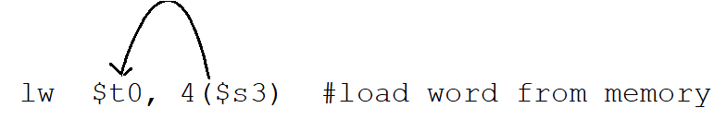
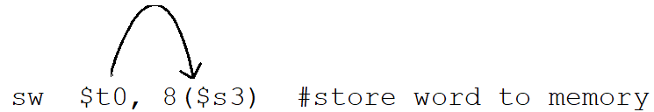
MIPS Memory Access Instructions
MIPS has two basic data transfer instructions for accessing memory
lw $t0, 4($s3) #load word from memory
sw $t0, 8($s3) #store word to memory
Memory Locations=(2² * 2³⁰)=4 Giga Locations
Notes:
Note that the offset can be positive or negative.
Offsets must be able to access bytes as well, so word offsets will have two low-order zeros in them.

Slide 3
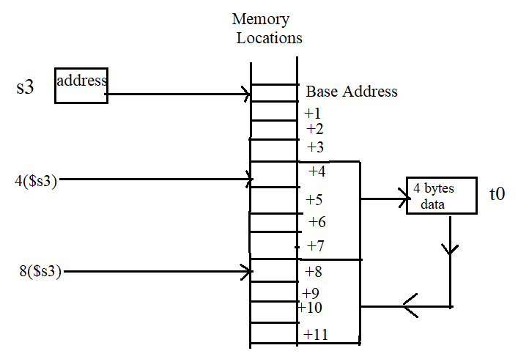
lw $t0, 4($s3)
sw $t0, 8($s3)

Slide 4


Memory Operand Example 1
C code:
g = h + A[8];
g in $s1, h in $s2, base address of A in $s3
Compiled MIPS code:
Index 8 requires offset of 32 bytes
4 bytes per word
lw $t0, 32($s3) # load word add $s1, $s2, $t0

Slide 5
Memory Operand Example 2
C code:
A[12] = h + A[8];
h in $s2, base address of A in $s3
Compiled MIPS code:
Index 8 requires offset of 32 bytes
Index 12 requires offset of 48 bytes
lw $t0, 32($s3) # load word add $t0, $s2, $t0 sw $t0, 48($s3) # store word

Slide 6
Machine Language - Load Instruction
Load/Store Instruction Format (I format):
lw $t0, 24($s3)
35 19 8 24₁₀
Memory
24₁₀ + $s3 =
0xf f f f f f f f
. . . 0001 1000
+ . . . 1001 0100
. . . 1010 1100 =
0x120040ac
$t0
0x120040ac
$s3
0x12004094
0x0000000c
0x00000008
0x00000004
0x00000000
data
word address (hex)
Notes:
destination address no longer in the rd field - now in the rt field
offset limited to 16 bits - so can’t get to every location in memory (with a fixed base address)

Slide 7
Aside: Loading and Storing Bytes
MIPS provides special instructions to move bytes
lb $t0, 1($s3) #load byte from memory
sb $t0, 6($s3) #store byte to memory
0x28 19 8 16 bit offset
What 8 bits get loaded and stored?
load byte places the byte from memory in the rightmost 8 bits of the destination register
what happens to the other bits in the register?
store byte takes the byte from the rightmost 8 bits of a register and writes it to a byte in memory
lh and sh-load half word and store half word
Notes:
load byte takes the contents of the byte at the memory address specified, zero-extends it, and loads it into the register
Store byte leaves the other bits in the memory word intact.

Slide 8
